Slide 1
Abortion Legislation and Emergency Medicine
Andreia B. Alexander, MD, PHD, MPH
Assistant Professor of Emergency Medicine
Indiana University School of Medicine

Slide 2
Why this matters
We must consider emergency medicine when discussion abortion legislation because these laws can
  delay or complicate care for pregnancy-related emergencies
  increase risks to patient safety
  creating legal and ethical challenges for clinicians

Slide 3
General Effects of Abortion Legislation

Slide 4
An Ethnographic Study of Vaginal Bleeding in Emergency Care
Purpose:
To examine and describe the decision-making process of healthcare professionals as they care for patients who are experiencing vaginal bleeding in the emergency setting.

Slide 5









Our team
Kathryn LaRoche
Risa Cromer
Andreia Alexander
Brownsyne Tucker-Edmonds
Lori Freedman
PhD, MSc Public Health/Anth
PhD Anthropology
MD, PhD, MPH Emergency Med
MD, MPH, MS Ob/Gyn
PhD Sociology/ANSIRH

Slide 6
Methods
Team-based ethnography of vaginal bleeding care in two Indiana hospital emergency care settings
Level 1 Trauma Center with no L&D
Separate OB ED triage area staffed by OB/GY
Intermittent observations
Patients
Clinicians (Physicians, APPs)
Nursing
Social Work
Case managers
In-depth interviews with clinicians (LF, RC, KL)
September 2023 to October 2024

Slide 7
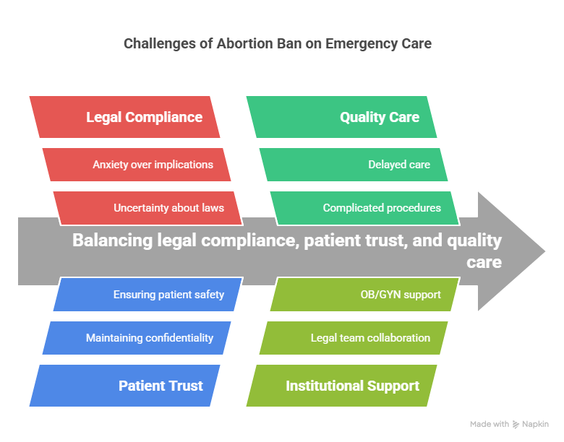
“I guess part of me doesn't—part of me, at least, doesn't want to know. I certainly don’t want to, like, have to document that this girl did something potentially illegal or something like that.” — ED18MD (Legal Compliance)
“We are not here to judge... It’s like when we ask the patient if they’ve done any illegal substances... we just want to make sure we have the accurate history to make sure that we are taking care of you appropriately.” — ED17NP (Quality Care)
“I know, for me personally, again, you know, because I do not want to ever destroy the trust that a woman has in the medical system, I would probably err on the side of being a little bit more vague with my answers to some of those questions to make sure that she was being protected... there's always that in the back of your head... are they going to be able to go back and, you know, somehow do something to this woman because she had this procedure?” — ED14MD (Patient Trust)
Clinical decision making

Slide 8
Key Points
EDs often serve as the first point of contact for patients with early pregnancy complications, making this setting particularly sensitive to the effects of restrictive laws.
Clinicians are caught between following vague or punitive laws and their ethical commitment to patient care.
Legal risk shifts information-gathering from curiosity or care-based to protection-based.
We are moving to a more centralized approach regressing our efforts away from an integrated approach.

Slide 9
Key Points
Clinicians interpret or misinterpret what must be reported creating increased legal issues for patients
Variability between institutions and individuals, potentially leading to unequal care or legal exposure.
Collaborations between ED clinicians, OBGYN and administration can reduce uncertainty and promote safer practices.

Slide 10
Effects of EMTALA Legislation

Slide 11
What is EMTALA?
Emergency Medical Treatment and Labor Act:
A federal law enacted in 1986 that requires hospitals with emergency departments to provide a medical screening exam and stabilizing treatment to any patient who comes to the emergency department, regardless of their insurance status or ability to pay. EMTALA was designed to prevent "patient dumping" and ensure timely, equitable emergency care.

Slide 12
Idaho v. United States & EMTALA
Aug. 2022
DOJ sues Idaho, arguing abortion ban violates EMTALA.
Aug. 2022
Federal judge blocks part of Idaho’s law for emergencies.
Apr. 2023
9th Circuit lifts the injunction, allows full ban.
Apr. 2024
Supreme Court hears Idaho v. U.S.
June 2024
Supreme Court dismisses the case as improvidently granted.
Mar. 2025
DOJ voluntarily drops lawsuit under new administration.
Mar. 2025
St. Luke’s wins injunction protecting its physicians.
Apr. 2025
State court expands medical emergency exception.

Slide 13
Why does this matter?
Emergency physicians must act quickly and decisively to save lives—any delay can have fatal consequences.

Slide 14

The Baseball Analogy
If a batter hesitates for even a split second, he misses the ball. In emergency medicine, that hesitation could mean a lost life.

Slide 15
A Real Case: 3AM Emergency
A young pregnant woman came in at 3AM with abdominal cramping and significant vaginal bleeding.
Vitals: High heart rate, normal blood pressure.
Actions: IV fluids, pain relief, ultrasound showed a fetal heartbeat. Bleeding uncontrolled.

Slide 16
Clinical Dilemma
Pelvic exam revealed an open cervix—pregnancy no longer viable, but still a fetal heartbeat.
Misinterpretation of legal restrictions delayed care.
OB/GYN had to consult legal before intervening—30-minute delay at 3AM.

Slide 17
Patient Outcome
While waiting for legal clearance, the patient deteriorated.
Required emergency D&C in the ED. Fetus did not survive. Patient developed complications, required hysterectomy.
This was her first and last pregnancy.

Slide 18
Why EMTALA Matters
EMTALA could have prevented this outcome.
In emergency medicine, we rely on instincts and training to act fast. Some patients bleed for hours without decompensating—others crash suddenly.
We need the legal protection to act without delay.

Slide 19
The Bigger Picture
Excluding pregnant women from EMTALA
will result in avoidable deaths!
Do you want your emergency physician to:
Stop and call legal counsel?
Worry about jail or losing their license?
Or act immediately to save a life?

Slide 20
Conclusion
Not all stories have a bad ending!
The intersection of abortion legislation and emergency care is complex.
We must be careful—lives are at stake.
EMTALA isn’t perfect, but it is essential.
Let’s protect all patients, including pregnant ones.

